Slide 1
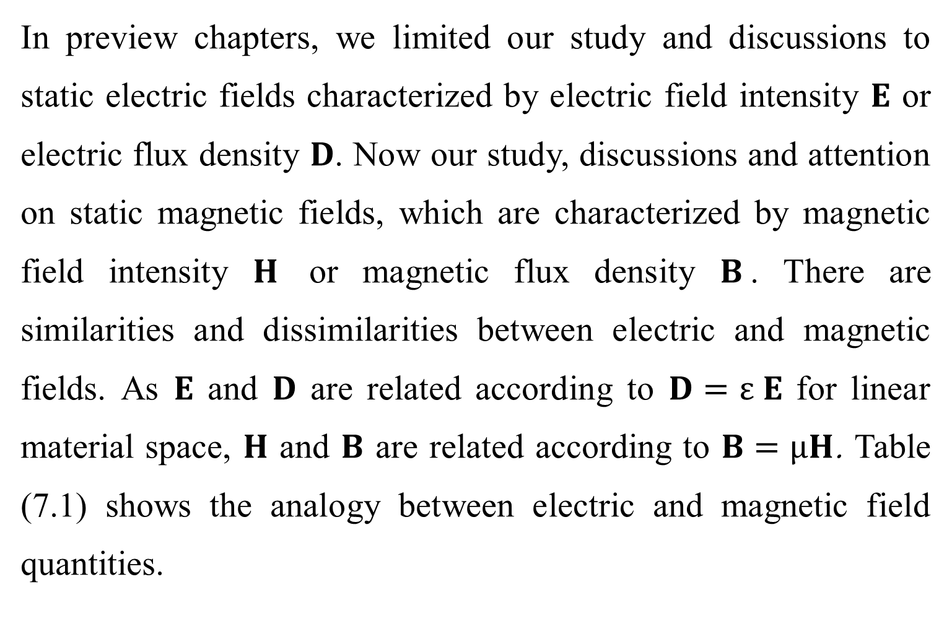
7.1 INTRODUCTION.
In preview chapters, we limited our study and discussions to static electric fields characterized by electric field intensity $E$ or electric flux density $D$. Now our study, discussions and attention on static magnetic fields, which are characterized by magnetic field intensity $H$ or magnetic flux density $B$. There are similarities and dissimilarities between electric and magnetic fields. As $E$ and $D$ are related according to $D=ε E$ for linear material space, $H$ and $B$ are related according to $B=µH$. Table (7.1) shows the analogy between electric and magnetic field quantities.

Slide 2
We have noticed that, an electrostatic field is produced by static or stationary charges. If the charges are moving with constant velocity, a static magnetic (magnetostatic) field is produced. Therefore, the source of the steady magnetic field may be a permanent magnet, an electric field changing linearly with time, or a direct current. This current flow may be due to magnetization currents as in permanent magnets, electron-beam currents as in vacuum tubes, or conduction currents as in current-carrying wires. In this chapter, will treat the magnetic fields of constant currents we consider magnetic fields of constant currents in free space.

Slide 3
Our study of static magnetic field is an indispensable necessity. The development of the motors, transformers, microphones, compasses, telephone bell ringers, television focusing controls, advertising displays, magnetically levitated high-speed vehicles, memory stores, magnetic separators, and so on, involve magnetic phenomena and play an important role in our everyday life.

Slide 4
There are two major laws governing magnetostatic fields:
(1) Biot-Savart's Law: Biot-Savart's law is the general law of static magnetic fields and it's like Coulomb's law in electric field.
(2) Ampere's Circuit Law: as Gauss's law is a special case of Coulomb's law, Ampere's law is a special case of Biot-Savart's law and is applied in problems involving symmetrical current distribution [2].
As we discussed the electric field, we shall confine our initial discussion for magnetic fields in free space conditions, and then effect of that fields in material media will also be saved for discussion [1].

